Slide 1



Basic Details of Team and Problem
Track Number: 02
Track Name: Fake and Spurious Link/URL Detection App
Problem Statement Title: To develop a platform that detects the fake and spurious link/URLs.
Team Name: SICK-CODE
Team Leader Name: Sushant Kumar
University School of Studies (USS): University School of Automation and Robotics

Slide 2
Team Member Details
Team Leader Name: Sushant Kumar 11119051622
Program :B.Tech(AI & ML) School : USAR Year :II
Team Member 1 Name: Deekshant Tilwani 11919051722
Program :B.Tech(IIOT) School : USAR Year :II
Team Member 2 Name: Khusbu Rai 03219051622
Program :B.Tech(AI & ML) School : USAR Year :II
Team Member 3 Name: Khushi 04819051622
Program :B.Tech(AI & ML) School : USAR Year :II

Slide 3




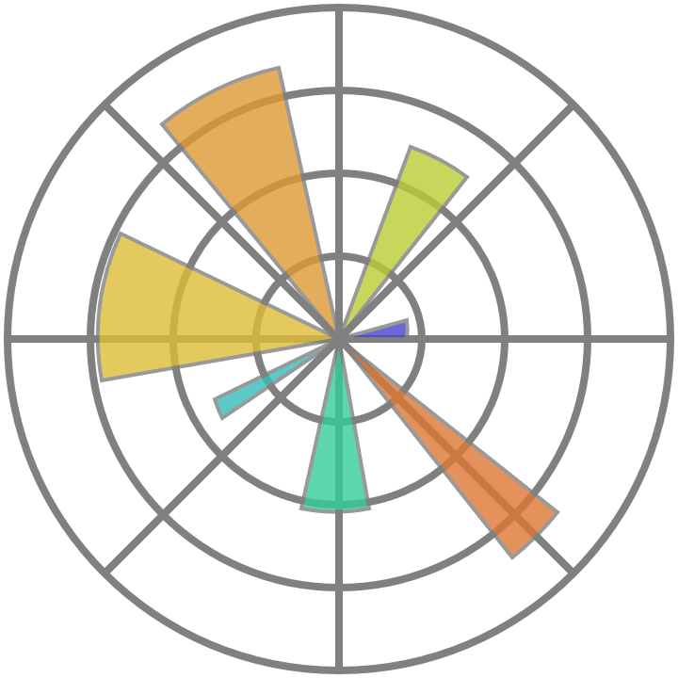

Workflow Details
Solution
This platform uses machine learning algorithms like Random Forest to detect fake websites.
Feature engineering involves extracting lexical features from raw URLs to identify indicators of potentially malicious websites.
Platform also ensures that a website have SSL certificate or not.
Technology Stack
Made with HTML, CSS, JS and Python libraries

Slide 4
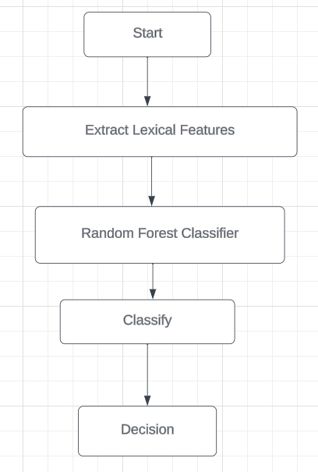
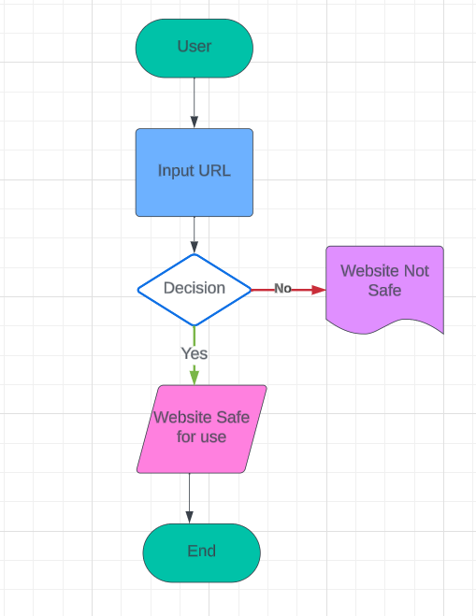
Workflow Details
Flow chart of prototype
Foreground Process
Background Process

Slide 5
Workflow Details
Possible Use Cases
Cybersecurity
Phishing Prevention
E-commerce
Financial Institutions
Social Media
Government Agencies
Dependencies /stopper (Limitations/Challenges)
Limited Dataset
Feature Engineering Complexity
Scalability
External Factors

